Slide 1

PROJECT REVIEW ON INSPECTION OF MECHANICAL JOB USING IMAGE PROCESSING AND DEEP LEARNING
Submitted in partial fulfillment of B.E.(ENTC)
To
Sinhgad Academy of Engineering, Kondhwa, Pune
Made By:-
Anish Adhikari
Kartik Gangavati
Purushottam Rathi
Ruchir Shrikhande
Guided By:-
M.M.Patil Ma’am

Slide 2
PROBLEM STATEMENT
The aim of our project is build a device which will inspect the produced mechanical jobs and inform the operator whether the job is completed, ready to use or is incomplete and cannot be used. The device will reduce the required human effort and error.

Slide 3
INTRODUCTION
These days “Computer vision sysytems”are being extensively used in industrial sector, especially in developing image based automatic inspection system.
These systems are mainly used to examine quality assessment of mechanical jobs in industries.
Scrutiny of these mechanical jobs by using these systems can be very helpful as:-
It avoids the human error caused by the manual labour during the inspection of mechanical jobs and hence it is more accurate.
By defect detection we can ensure the quality of the mechanical job at the pre-processing stage.
It detects the defective objects by comparing it with a pre-fed image from the database.
As the object is compared with the pre-fed image it can scrutinize
the object properly and thus giving us fruitful results.

Slide 4
LITERATURE REVIEW
Appropriate mechanical job selection and quality management are growing in importance in industrial development and production.
The decentralized production of components by suppliers means that tight specifications have to be met to ensure problem free assembly in final production, resulting in a high quality final product.
Test engineers strive to catch defects before the product is released but they always creep in and they often reappear, even with the best manual testing process.
Image processing is the best way to increase the effectiveness, efficiency and coverage for job selection. Typical features such as hole patterns as well as borders, sharp edges, elongated holes can be measured with Quality Control using Image Processing (QCUIP).
It also shows the deviation for a fast evaluation of processing. This means early detection of potential problems so that processes can be corrected in a timely manner, resulting in lower production cost and efficient quality control.
Companies that implement these techniques benefit from shorter production time for products and also can ensure a good quality product.

Slide 5
MOTIVATION
Computer vision systems are widely implemented in automatic inspection systems. The quality management of mechanical parts in industries is vital for appropriate job selection.
Defect detection should be done in the pre-production stage to ensuring quality control. Real time inspection using manual labour is inadequate, time consuming and non-consistent.
Hence there is a need for a system which is built for automatic defect detection which will help in finding out if a particular job can be used or not, such that it avoids human errors and is comparatively accurate.
The system builds a computer vision system which detects the defective objects by comparing it with a preferred image from the database.
Pattern recognition is performed to identify the defective objects. It identifies the surface irregularities and scrutinize the given job and give us a desired result.

Slide 6
BLOCK DIAGRAM

Slide 7
EXPLANATION
Digital Image Processing techniques are employed to verify almost all the products that are coming out of the product line. This is executed using the following steps.
Image Classification
This is the first step in the process of mechanical job inspection. Here, we create a dataset for each mechanical job using a camera. This gives us a total of seven datasets each consisting of about a hundred images.
Data Labeling
In this process manually label the input data so that the Deep Learning algorithm can eventually learn to make the predictions on its own. The objective at this point will be to identify the mechanical job under inspection by comparing it with the available images stored in the datasets.
CNN
By using convolution neural network aka CNN, type of objects in an image can be detected with ease. In order to achieve this, we execute the following steps:-

Slide 8

Convolution Operation
Convolute input image with feature detector, number of matching points which gives feature map. We create many feature maps to obtain our first convolution layer.
ReLU Layer
The main purpose of applying rectifier transform is to increase the non-linearity in our network.
Pooling
Pooling is also called as downsampling, for our system we are using max pooling. The main purpose of max pooling is to extract important features from the feature map.

Slide 9
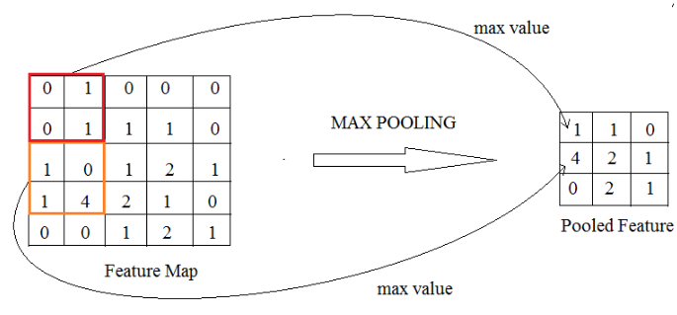
Pooling Operation
Flattening
Flattening is converting the data into a 1-dimension array for inputting it to the next layer. Flattening transforms a two-dimensional matrix of features into a vector that can be fed into a fully connected neural network classifier.

Slide 10
Full connection
A fully connected layer also known as the dense layer, in which the results of the convolutional layers are fed through one or more neural layers to generate a prediction label.
Softmax and cross entropy
After the labels are generated, we employ the soft max and cross entropy function in which the final probabilities of each label is determined. Higher the probability, higher is the accuracy of mechanical job inspected.
DIMENSIONS INSPECTION/VALIDATION
Finally the image is subjected to some threshold operations
wherein the dimensions of the mechanical job is calculated and then compared with the expected dimensions. If the calculated dimensions matches with the expected dimensions then the mechanical job is considered to be error free which gets displayed on the LCD and by glowing of an LED.

Slide 11
IDENTIFIED MECHANICAL JOB
The first image represents the image imported from the dataset. This dataset is of the mechanical job which is kept for inspection.
This image then goes through various operations such as, BGR to gray conversion, thresholding & dilation.
The final image represents the identified mechanical job and it’s dimensions.

Slide 12
GRAPH FOR MODEL ACCURACY

Slide 13
HARDWARE
Components Used:-
Raspberry Pi 3b
Camera Module
IR sensor
16X2 LCD
LED

Slide 14
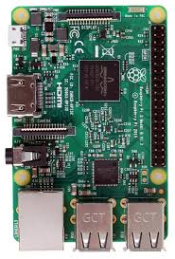
Raspberry Pi 3
The Raspberry Pi 3 Model B is the earliest model of the third-generation Raspberry Pi. It replaced the Raspberry Pi 2 Model B.
Quad Core 1.2GHz Broadcom BCM2837 64bit CPU and 1 GB of RAM.
BCM43438 wireless LAN and Bluetooth Low Energy (BLE) on board.
It has 40-pin extended GPIO and 4 USB 2 ports.
Full size HDMI
CSI camera port for connecting a Raspberry Pi camera
DSI display port for connecting a Raspberry Pi touchscreen display
Micro SD port for loading your operating system and storing data
Upgraded switched Micro USB power source up to 2.5A.

Slide 15
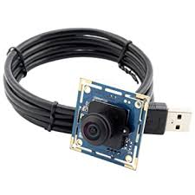
Camera Module
The 8MP Raspberry Pi Official Camera Module v2 can be used to take high-definition video, as well as stills photographs. It uses high quality 8 megapixel Sony IMX219 image sensor custom designed add-on board for Raspberry Pi, featuring a fixed focus lens.
It is capable of 3280 x 2464 pixel static images, and also supports 1080p30, 720p60 and 640x480p 60/90 video.
Applications
CCTV security camera
Motion Detection
Time Lapse Photography etc.

Slide 16
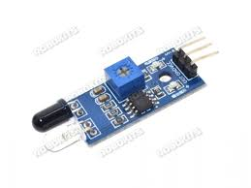
IR Sensor
Infrared Obstacle Sensor Module has built in IR transmitter and IR receiver that sends out IR energy and looks for reflected IR energy to detect presence of any obstacle in front of the sensor module. The module has on board potentiometer that lets user adjust detection range. The sensor has very good and stable response even in ambient light or in complete darkness
Operating Voltage: 3.0V – 5.0V
Detection range: 2cm – 30cm (Adjustable using potentiometer)
Current Consumption : at 3.3V : ~23 mA , at 5.0V: ~43 mA

Slide 17
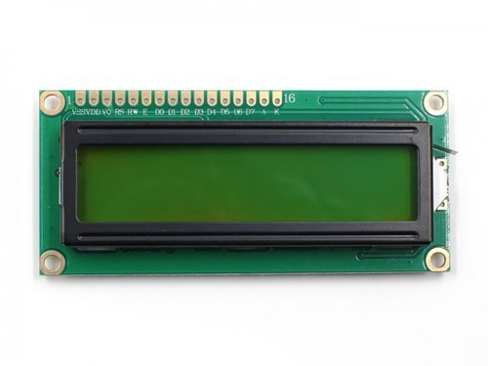
16x2 LCD
The term LCD stands for liquid crystal display.
An LCD is an electronic display module which uses liquid crystal to produce a visible image.
The 16×2 translates o a display 16 characters per line in 2 such lines. In this LCD each character is displayed in a 5×7 pixel matrix.

Slide 18
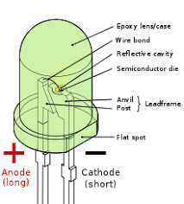
LED
A light-emitting diode (LED) is a semiconductor device that emits light when an electric current is passed through it.
Light is produced when the particles that carry the current (known as electrons and holes) combine together within the semiconductor material.
Since light is generated within the solid semiconductor material, LEDs are described as solid-state devices. The term solid-state lighting, which also encompasses organic LEDs (OLEDs), distinguishes this lighting technology from other sources that use heated filaments (incandescent and tungsten halogen lamps) or gas discharge (fluorescent lamps).

Slide 19
SOFTWARE/ENVIRONMENT DESCRIPTION
Spyder
Spyder is an open source cross-platform Integrated Development Environment (IDE) for scientific programming in the Python Language. Spyder integrates with a number of prominent packages in the scientific Python stack, including Numpy,Pandas,IPython,Cython,etc as well as other open-source software.It is released under the MIT license.Spyder uses Qt for its GUI and is designed to use either of the PyQt or Pyside Python bindings.
Features:-
Support for multiple IPython Consoles
Static code analysis, powered by Pylint
A run-time Profiler to benchmark code

Slide 20
Open CV
OpenCV (Open Source Computer Vision Library) is a library programming functions mainly aimed at real-time computer vision. Originally developed by Intel, it was later supported by Willow Garage then Itseez (which was later acquired by Intel). The library is cross platform and free for use under the open source Apache 2 License.
Applications:-
2D and 3D feature toolkits
Egomotion estimation
Facial Recognition System
Gesture Recognition System

Slide 21
Keras
Keras is an open-source software library that provides a Python interface for artificial neural networks. Keras acts as an interface for the Tensorflow library.Keras contains numerous implementations of commonly used neural-network building blocks such as layers, objectives, activation function, optimizer and a host of tools to make working with image and text data easier to simplify the coding necessary for writing deep neural network code. In addition to standard neural networks, Keras has support for convolutional and recurrent neural networks. It supports other common utility layers like dropout, batch normalization and pooling.
Tensorflow
TensorFlow is a free and open-source software library for machine learning. It can be used across a range of tasks but has a particular focus on training and interface of deep neural networks. Tensorflow is a symbolic math library based on dataflow and differentiable programming. It is used for both research and production at Google.

Slide 22
FUTURE SCOPE
Use of better algorithm, processor, camera will make the process faster and accurate.
Improving the training and testing will improve the efficiency of the device.
Adding more convolution will also increase the performance of the device.

Slide 23
ADVANTAGES
Real time inspection using manual labour is inadequate, time consuming and non-consistent. It avoids the human error caused by the manual labour during the inspection of mechanical jobs and hence it is more accurate.
Image processing is the best way to increase the effectiveness, efficiency and coverage for job selection. Typical features such as hole patterns as well as borders, sharp edges, elongated holes can be measured with Quality Control using Image Processing (QCUIP).
By defect detection we can ensure the quality of the mechanical job at the pre-processing stage. This means early detection of potential problems so that processes can be corrected in a timely manner, resulting in lower production cost and efficient quality control
It detects the defective objects by comparing it with a preferred image from the database.As the object is compared with the preferred image it can scrutinizethe object properly and thus giving us fruitful results.
Companies that implement these techniques benefit from shorter production time for products and also can ensure a good quality product.

Slide 24
LIMITATIONS
It requires very large amount of data in order to perform better than other techniques.
It is extremely expensive to train due to complex data models. Moreover deep learning requires expensive GPUs and hundreds of machines. This increases cost to the users.

Slide 25
REFERENCES
1)Kah W. Ng and Kee S. Moon, Measurement of 3-D Tool Wear Based on Focus Error and Micro-Coordinate Measuring System, Decision and Control, 1998. Proceedings of the 37th IEEE Conference, Volume: 3.
2)B. Dhanasekar and B. Ramamoorthy, Evaluation of Surface Roughness Using an Image Processing and Machine Vision System, Journal Metrology Society of India, Vol.21, No.1,2006, pp, 9-15.
3)Moreels, P., Perona, P.,: Evaluation of Features Detectors and Descriptors Based on 3D Objects. 73(3), 263–284 (2007).
4)Jenn-Yih Chen, Bean-Yin Lee, Kuang-Chyi Lee, Zhao-Kai Chen, Development and Implementation of a Simplified Tool Measuring System, Measurement Science Review, Volume 10, No. 4, 2010, pp, 142-146.
5) Jain, T, Meenu, Automation and Integration of Industries Through Computer Vision Systems. International Journal of Information and Computation Technology. 3(9), 963-970 (2013).

Slide 26
THANK YOU

